Slide 1
Tangible Property Regulations
Presented by
David W. Jennings, CPA

Slide 2
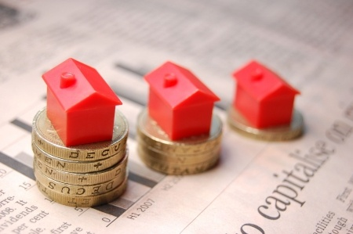
Tangible Property Regulations
Determining the unit of property
Improvement Standards

Slide 3
Amounts Paid To Improve Tangible Property
Treas. Reg. § 1.263 (a)-3
Determine the unit of property
Apply the improvement standards
Consider the routine maintenance safe harbor

Slide 4
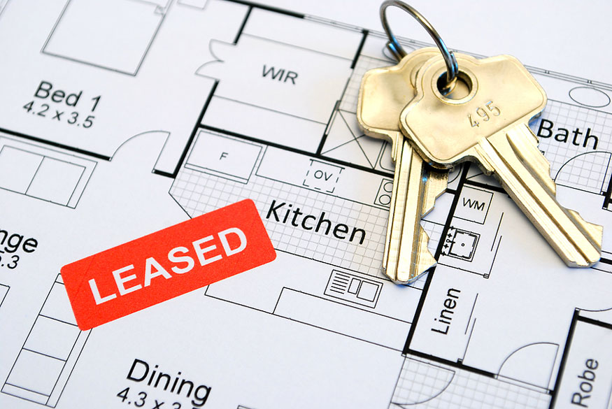
Determine The Unit of Property (“UoP”)
General rule is that all components that are functionally interdependent are a single UoP
If taxpayer depreciates a component of a UoP under a different asset class from UoP, then component is the UoP
Special rules
Buildings
Leased property
Plant property
Network assets

Slide 5
UoP – Buildings
UoP is the building and structural components
To determine if UoP is improved, look at each of the following:
Building systems:
Heating, ventilation, and air conditioning systems (HVAC)
Plumbing systems
Electrical systems
All escalators
All elevators
Fire protection and alarm systems
Security systems
Gas distribution systems
Other structural components identified in published guidance
Building structure, which is defined as the building and its structural components (other than the sub-systems above)

Slide 6
What Is An “Improvement?”
An “improvement” is defined under §1.263(a)‐3(d) as an amount paid after the property is placed in service which:
Betterment – Results in a betterment to the UoP
Adapts the UoP to a new or different use
Restores the UoP
B-A-R = Improvement (Capitalize)

Slide 7
What Is A “Betterment?”
Corrects a material condition or defect existing prior to the taxpayer’s acquisition
Is a material addition (enlargement, expansion, extension)
Is a material increase in capacity, productivity, efficiency, strength, quality, or output (Ex. Replace asphalt shingles with new solar shingles)
Enhancement due to technological advancements not necessarily betterment. (ex. HVAC equipment is always going to be more efficient. Is it comparable?)
“Material” ‐ IRS has not defined this!

Slide 8
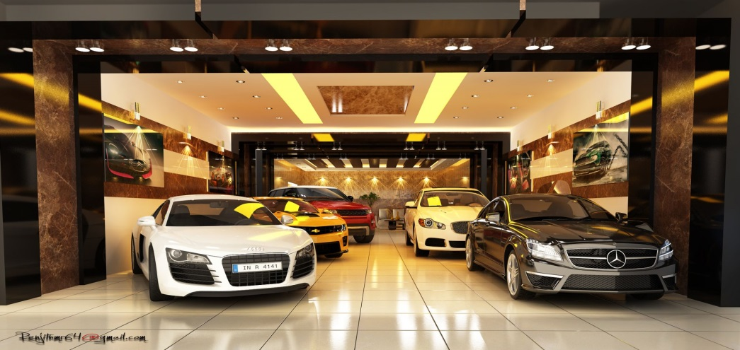
“Adaption”
If cost is incurred to adapt UOP to a use different than when originally placed in service
Example – A converts its manufacturing building into a showroom for its business
Removes and replaces various structural components to provide a better layout for the showroom and its offices
Must capitalize the amount paid to convert the building into a showroom because the conversion to a showroom is not consistent with A's ordinary use of the building structure at the time it was placed in service

Slide 9
What Is A “Restoration?” 1.263(a)-3(k)
Restoration only if:
Returns UOP to ordinary operating condition – if in state of disrepair & no longer functional
Replacement of major component or substantial structural part
Rebuilds UOP to like‐new condition after end of class life
Class life – 168(g)(2) and (3) for purposes of the alternative depreciation system
Replaces component deducted as loss; or adjusted basis taken into account for loss/gain
Repair component after casualty loss/event if basis adjusted

Slide 10
Restoration
For Buildings – It is a replacement of a Major Component or Substantial Structural Part if:
Replacement includes parts that comprise a major component or a significant portion of a major component of a building or building system
Must first identify the major component of a building system. Then see if a significant portion was replaced

Slide 11
Definitions
Structural Components – lots of things. Walls, windows, doors, roof etc. See reg 1.48-1(e)(2)
Building System – Nine items listed (HVAC, Plumbing, etc.)
Major Component – Performs a discrete and critical function
Substantial Structural Part – Large portion of the physical structure

Slide 12
Unit of Property
Common Examples of Building System Components
Building Unit(s) of Property and Common Components
Building Structure | Heating Ventilation and Air “HVAC” | Plumbing Systems | Electrical Systems | All Elevators
Roof Walls Floors Ceilings Foundation | Motors Compress Boilers Furnace Chillers Pipes Ducts Radiators | Pipes Drains Valves Sinks Bathtubs Toilets Water and Sanitary Sewer Collection Equip. Water Utility Equip. | Wiring Outlets Junctions Lighting Fixtures & Connectors Elec. Utility Equip. | Elevator boxes Control Equip. Cables and Movement Equip.
All Escalators | Fire Protection and Alarm Systems | Security Systems to Protect Building and Occupants | Gas Distribution System
Rails Steps Supporting Equip. Controls | Sensing & Detection Devices Computer Controls Sprinkler Heads & Mains Piping & Plumbing Alarms Control Panels Signage | Window & Door Locks Security Cameras Recorders Monitors Motion Detectors Security Lighting Alarms Entry Access | Pipes Gas Equip.

Slide 13
Restoration Examples HVAC Systems
Example # 16 – Office building with one HVAC System
Comprised of 3 furnaces, 3 AC units, and duct work throughout the building
1 Furnace breaks down, replaced with a new furnace
The three furnaces together perform a critical function in operation of HVAC system
3 Furnaces = Major Component
However replacing a single furnace is not a significant portion of this major component of the HVAC System
Not a restoration of the UOP (HVAC system)

Slide 14
Restoration Examples HVAC Systems – Cont.
Example # 17 – Office building with one HVAC System
Comprised of 1 chiller, 1 boiler, cooling tower, etc.
Chiller is replaced with comparable unit
Chiller functions to cool water to generate AC
Chiller performs a discrete and critical function of HVAC system
Must Capitalize

Slide 15
Major Component/Substantial Structural Part Examples
Major Component/Substantial Structural Part
Engine and cab of truck tractor
Entire roof of manufacturing building (including decking, insulation, asphalt, and various coatings)
Chiller unit in office building HVAC system (e.g., chiller, boiler, pumps, duct work, diffusers, air handlers, outside air intake, cooling tower)
All wiring within a building's electrical system
Not a Major Component/Substantial Structural Part
Power switch assembly of drill press
Waterproof membrane of retail store roof (comparable to original membrane)
3 of 10 rooftop units in an office building HVAC system (e.g., 10 RTUs, system controls, duct work)
30% of the wiring within a building's electrical system

Slide 16
Major Component/Substantial Structural Part Examples – Cont.
Major Component/Substantial Structural Part
All toilets and all bathroom sinks (not including associated piping) in all restrooms in 3-floor retail building
200 of 300 exterior windows
300 windows represent 25% of building surface area
Wood floors in all public areas (e.g., lobby, hallways, meeting rooms, ballroom, etc.) of hotel
Not a Major Component/Substantial Structural Part
8 of 20 restroom sinks (not including associated piping) in 3-floor retail building
100 of 300 exterior windows
300 windows represent 25% of building surface area
1 of 4 elevators in office building (single elevator is not gain-or-loss property)

Slide 17
Routine Maintenance Safe Harbor
Deductible – must reasonably expect (at time UOP is placed in service) to perform more than once during class life (alternative depreciation system (ADS))
Safe harbor does not apply to Betterments, Adaptations, or some Restorations (see Reg. § 1.263(a)‐3(i)(3))
Consider – recurring nature of activity, industry practice, manufacturers‘ recommendations, and taxpayer's experience with similar property
FOR BUILDINGS: Deductible – must reasonably expect to perform more than once during the ten year period from when the building system was placed in service

