Slide 1
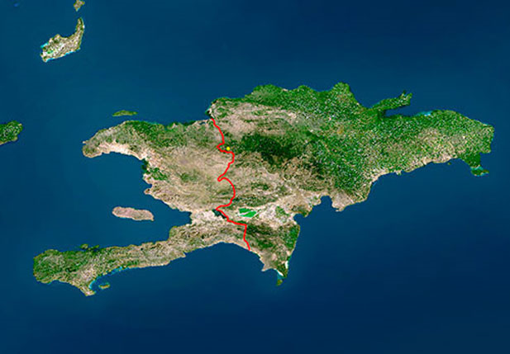
The to obvious difference between Haiti and Dominican Republic

Slide 2
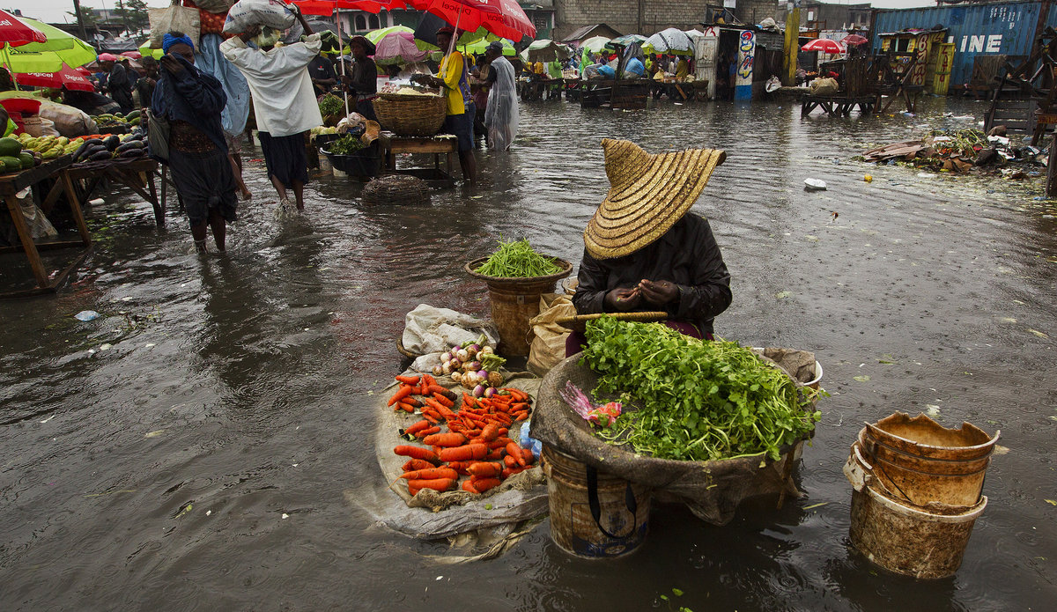
social and economic vulnerability robs them of all their strength to claim respect for their fundamental rights

Slide 3
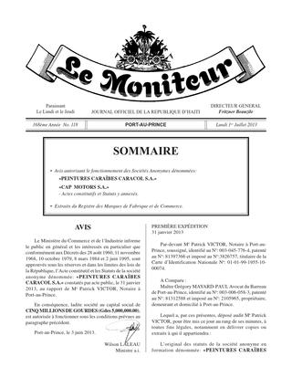
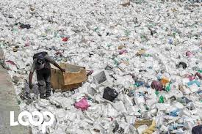
Decrees, decrees laws and laws are adopted

Slide 4
Together we can do so much

