Slide 1
The False Claims Act: Fraud in the Healthcare Setting
Shauna B. Itri, ESQ.
267-973-4265
www.linkedin.com/in/shaunaitri/

Slide 2
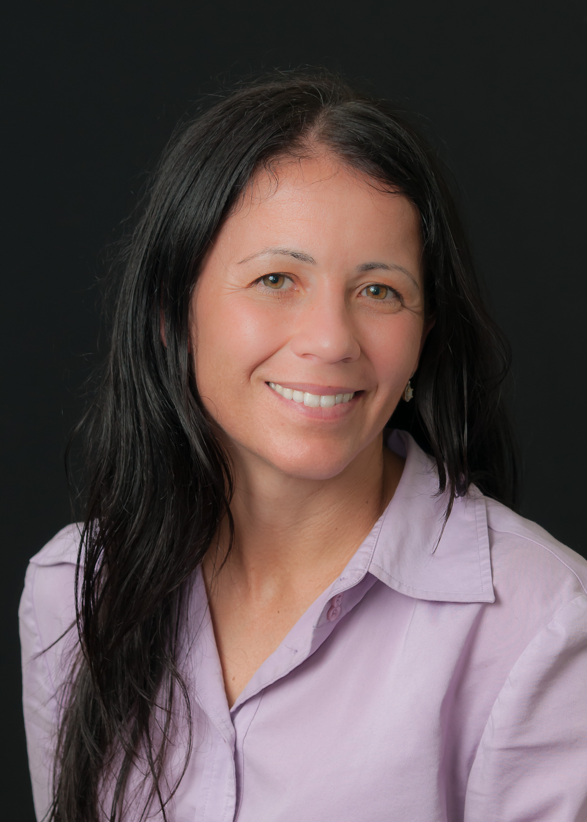
Speaker Biography: Shauna Itri
Shauna represents whistleblowers in False Claims Act law suits in state and federal courts throughout the United States, and tax and securities whistleblowers with claims under the IRS and SEC whistleblower programs. Ms. Itri received a B.A. and an M.A. from Stanford University, where she captained the University’s Women’s soccer team and received her J.D. from Villanova University. Ms. Itri is presently an adjunct professor at Widener Law School, teaching a white collar crime and corporate deviance course.

Slide 3
Audience Poll
Very Familiar with False Claims Act?
(Minimize the Background)
Some Familiarity with the False Claims Act?
(Reorient Me with the Background)
No Familiarity with the False Claims Act?
(More Background the Better)
In Compliance? Private Practice or Hospital Setting?

Slide 4
Introducing the False Claims Act

Slide 5
The False Claims Act
Allows citizens with evidence of fraud against government programs to sue……on behalf of the government
Whistleblower may be awarded a portion of the funds recovered

Slide 6
The False Claims Act, Procedurally Speaking

Slide 7
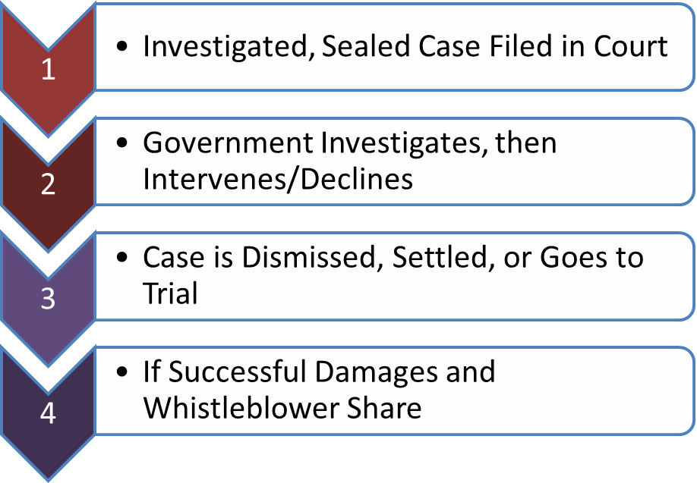
False Claims Act: Procedural Steps

Slide 8
The False Claims Act, Generally Speaking

Slide 9
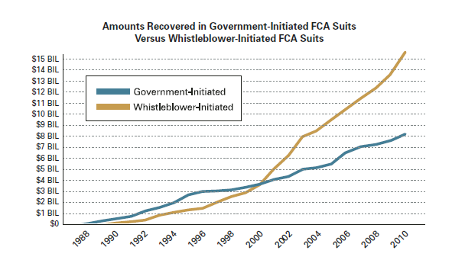
False Claims Act: Generally
“Lincolns Law” enacted in 1863
False Claims Act amendments in 1986
Important Tool In Fighting Government Waste, Fraud & Abuse
Over $40 billion recovered in 29 years

Slide 10
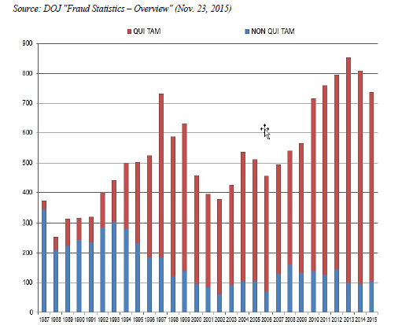
False Claims Act: New Matters

Slide 11
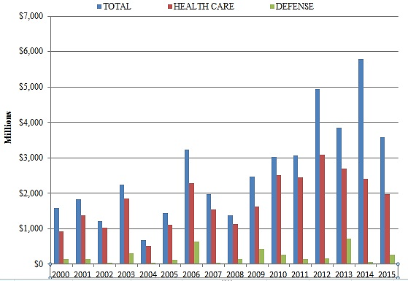
False Claims Act: Types of Cases Source: Gibson Dunn “2015 Year-End False Claims Act Update” (January 6, 2016)

Slide 12
Whistleblower (“Relator”) Share of the Recovery

Slide 13
Whistleblower Share
Most Cases are not joined by the Government (80% declined); Declined cases are generally dropped (80%)
Only 100-15 FCA cases a year are positively resolved; take on average 38 months but may take a decade
Government intervenes = 15 to 25% of the Recovery
Government Does Not Intervene = 25 to 30% of the Recovery
Planned and Initiated the Fraud = Share may be Reduced
Convicted of a Crime Arising From the Fraud = Dismissed Form the Case and Recover Nothing

Slide 14
What Do You Have to Prove?

Slide 15
False Claims Act Elements
false statement or engaged in fraudulent course of conduct
acted “knowingly”
the statement or conduct was material
caused the Government to pay out money or to forfeit money due

Slide 16
Examples of Fraud Under The False Claims Act

Slide 17
Examples of Fraud Under the False Claims Act
Inpatient v. Outpatient: Performing and billing
procedures as inpatient procedures when the government believe they should have been performed as outpatient procedures.
Unlicensed Billing: Billing for the services of improperly licensed personnel or for professionals excluded from participation in Medicare and Medicaid.
Upcoding: Falsely representing that patients received a more complex or expensive service than what was actually provided.

Slide 18
Examples of Fraud Under the False Claims Act: Continued
Charging For Services Or Supplies Not Provided : submitting claims to the Medicare or Medicaid for services or supplies that the provider did not deliver to a patient or beneficiary.
Falsifying or Failing to Maintain Records : Medicare and Medicaid will only reimburse a provider for services or supplies if those services or supplies are medically necessary. Providers are required to maintain various forms of documentation demonstrating medical necessity. If a provider or supplier either falsifies those records, or fails to maintain them, then the provider may be committing fraud when it submits claims for payment to the Medicare or Medicaid.

Slide 19
Grant Fraud and the False Claims Act

Slide 20
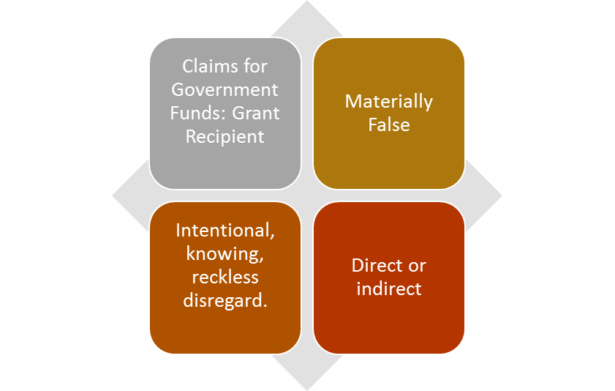
Grant Fraud: Case Study
“Northwestern University To Pay Nearly $3 Million To The United States To Settle Cancer Research Grant Fraud Claims” – Department of Justice.

Slide 21
Kickbacks: Payment (Kind) of Something of “Value” In Exchange for Referrals Any

Slide 22
Kickback Examples
NOT KICKBACKS: US ex rel. Shapiro v. Medtronic
General allegations; amounted to little more than claiming Medtronic sponsored conferences, reimbursed attendees for some expenses, provided food and promoted the devices.
KICKBACKS:
Sham Studies
Biovail $24 M Settlement in May 2008
Cardizem Sham Study
$1000 per enrollee
1 month: prescribe drug, three visits, small questionnaire
Stated objective accelerating uptake Rxs among doctors
Exorbitant payments (>FMV!!) in exchange for referrals
Employment Arrangements above FMV: Tuomey Hospital (verdict $45million) and Covenant Medial Center (settlement $4.5million)
Sham Directorships: McAllen Hospitals ($25 million settlement)
Bogus Lease Arrangements: see above

Slide 23
Clinical Trial Billing

Slide 24
Clinical Trial Billing Fraud Examples
Billing for services that are part of a non-qualifying clinical trial
Double Billing
Using Research Funds for Routine Care

Slide 25
Off-Label Marketing of Drugs

Slide 26
Off-Label Marketing Examples
Off-label use is the use of drugs/devices for an unapproved
indication or in an unapproved age group, unapproved dosage, or
unapproved form
Drugs: U.S. ex rel. Franklin v. Parke-Davis: Pfizer promoted Neurotonin (indicated for seizures associated with epilepsy) for pain/psychiatric disorders
Devices: U.S. ex rel. Colquitt v. Abbott Laboratories: scheme to thwart the FDA approval process for vascular stents by fraudulently obtaining FDA clearance for devices

Slide 27
Decision Making “Take-Aways”

Slide 28
Whistleblower Options
Not Report the Fraud at All (move on or potentially commit fraud)
Report the Fraud Internally - Company fixes the problem or explains why not fraud, Continue Fraud, Retaliation
Report the Fraud to Government – Deal With the Consequences
Explore Option of Filing a Whistleblower Case – Consult With Qualified Attorney Free of Charge

Slide 29
Pros and Cons of Filing and NOT Filing a Whistleblower Case

Slide 30
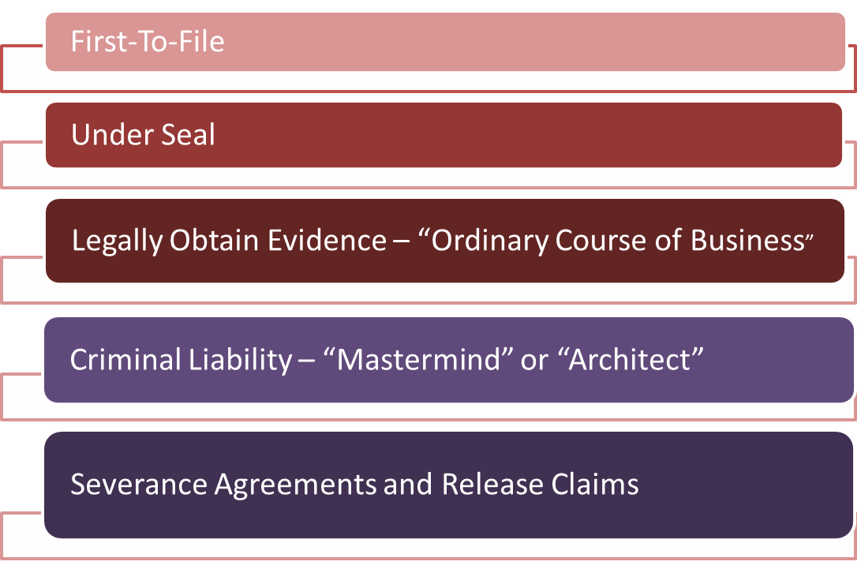
Traps for the Unweary

Slide 31
IRS Whistleblower Statute

Slide 32
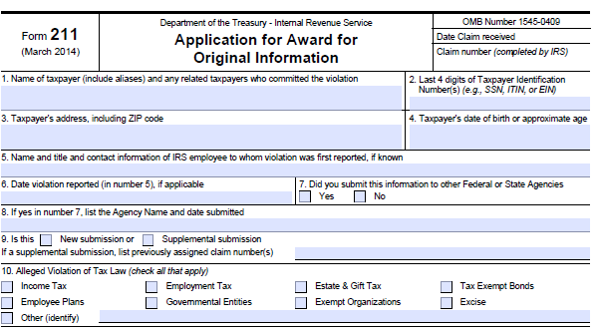
IRS Whistleblower Statute
Tax fraud can occur in a number of different ways, but generally speaking, it occurs when an individual falsifies information on personal or business tax forms or otherwise attempts to evade paying their taxes.

Slide 33
SEC Whistleblower Statute

Slide 34
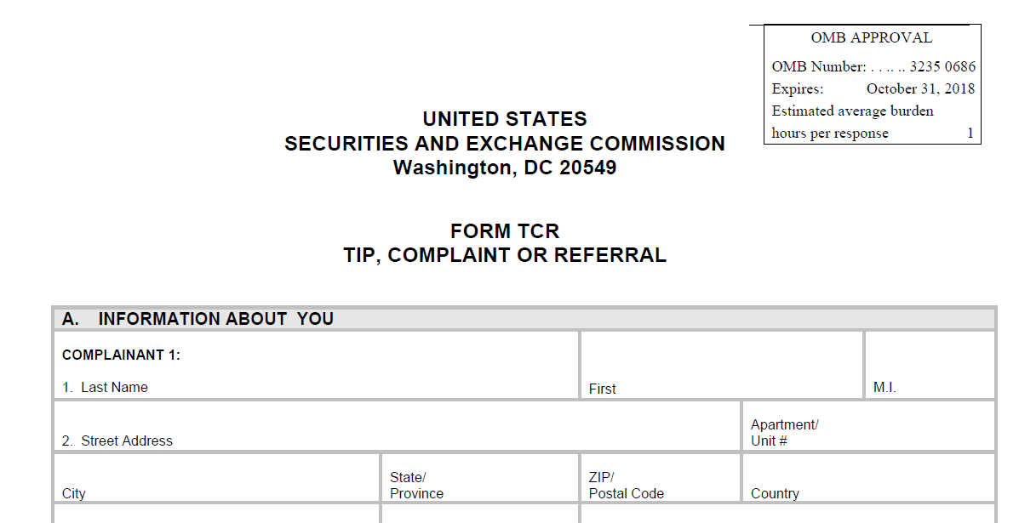
SEC Whistleblower Statute
Section 922 of the Dodd-Frank Wall Street Reform and Consumer Protection Act created to incentivize whistleblowers to disclose fraud in connection with financial securities to the SEC
Voluntarily provide
original information to
the SEC resulting in
monetary sanctions
exceeding $1 million.

Slide 35
Contact Information: SHAUNA ITRI sitri@bm.net 267-973-4265 www.linkedin.com/in/shaunaitri/

Slide 36
Introductions of Panelists

Slide 37
Cindy Groux Owner of Health Care Practice Management
Cindy founded Health Care Practice Management in 1992. Since that time the company has grown to fifty four practices with seventy providers operating in four different states. The company has grown from three to thirty employees with expertise in revenue cycle management, credentialing, consulting, billing software, and practice operations management. Additionally, she serves as an expert witness for attorneys and their clients in Delaware, Pennsylvania and NJ.
Cindy obtained her certification as a Certified Healthcare Billing and Management Executive through the Healthcare Billing and Management Association (HBMA) in April 1999, and is a graduate of the HBMA Compliance Implementation Course. She served six years on the Board of Directors for HBMA.

Slide 38
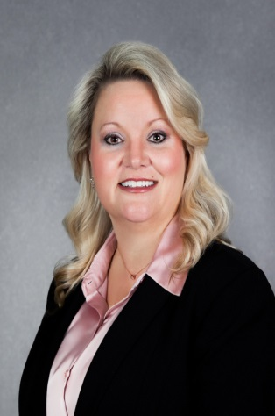
Christina Babenko Corporate Compliance Officer, Christiana Care Health System
Christine (Tina) Babenko is the Corporate Compliance Officer at Christiana Care Health System and the Compliance Officer for eBrightHealth ACO. She earned her Master of Jurisprudence in Health Law from Widener University Delaware Law School; a Master of Science in Nursing Executive Leadership; is Certified in Healthcare Compliance (CHC); Certified Compliance & Ethics Professional (CCEP) and is currently pursuing a Doctorate Degree in Organizational Learning, Leadership, and Innovation. In addition to her work at Christiana Care, Ms. Babenko is an adjunct Professor at a local university where she teaches courses related to healthcare policy and politics and has developed curriculum for Compliance Certification courses.

Slide 39
Patricia Resnik Vice President, Quality & Care Management, Christiana Care Health System
Ms. Resnik is also the Vice President of Carelink CareNow, a wholly owned care management subsidiary of Christiana Care. Ms. Resnik leads a number of programs at Christiana Care & Carelink CareNow in order to enhance the delivery of health care services, including programs in care management, utilization management, clinical documentation improvement, and population health management.
Ms. Resnik is certified in healthcare quality by the National Association of Healthcare Quality (NAHQ), and co-lead the development of the NAHQ “Essential Competencies: Regulatory and Accreditation” publication released in the spring of 2016. She is currently the vice-chair of the Delaware Local Program Committee for the Healthcare Leadership Network of the Delaware Valley (HLNDV).
Ms. Resnik earned a Master of Jurisprudence in Health Law from the Widener University Delaware Law School; a bachelor of science degree and her MBA from Widener University in Chester, Pennsylvania. She is a fellow of the American College of Healthcare Executives (ACHE) and a past recipient of that college’s Early Career Healthcare Executive award.

Slide 40
How to Respond to Concerns Reported Internally

Slide 41
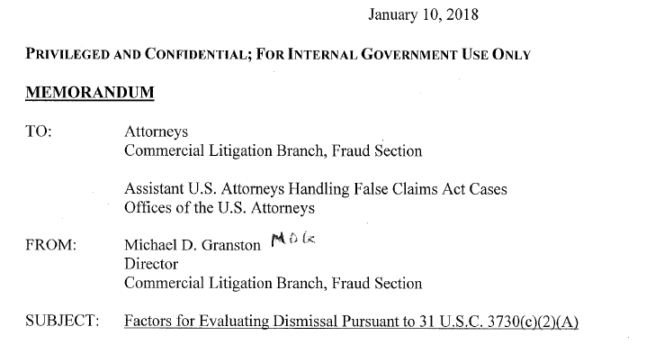
DOJ Memorandum and Impact on Internal Investigations

Slide 42
Inpatient v. Outpatient Issue: What Have We Learned?

Slide 43
Handling Increased Audits from Government and Commercial Payers

Slide 44
Target Probe and Educate (TPE) Audits for Facility and Professional Claims

Slide 45
Managing Conflicts of Interests: Consulting Arrangements, Medical Directorships and Speaking Engagements

