Slide 1
Dignity in the Classroom
Community Narratives:
Dignity Right to Tell EJ Stories
Helen H. Kang Environmental Law and Justice Clinic

Slide 2
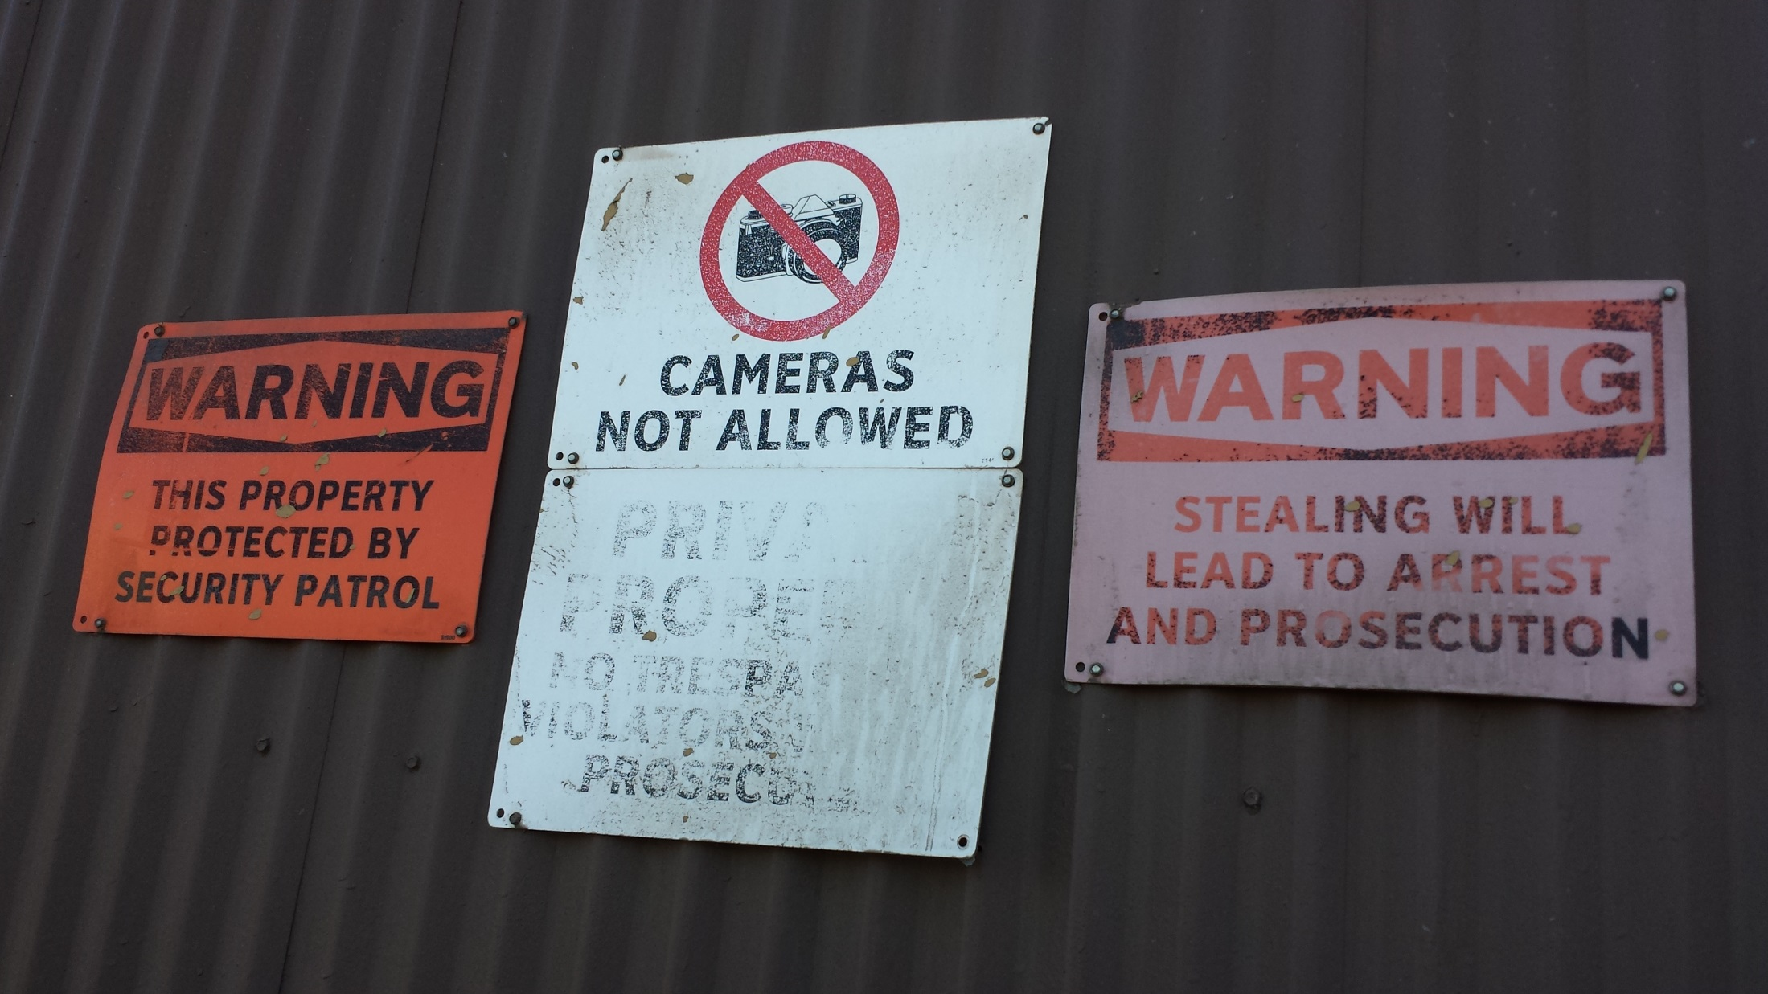
Subtitle
Body text

Slide 3
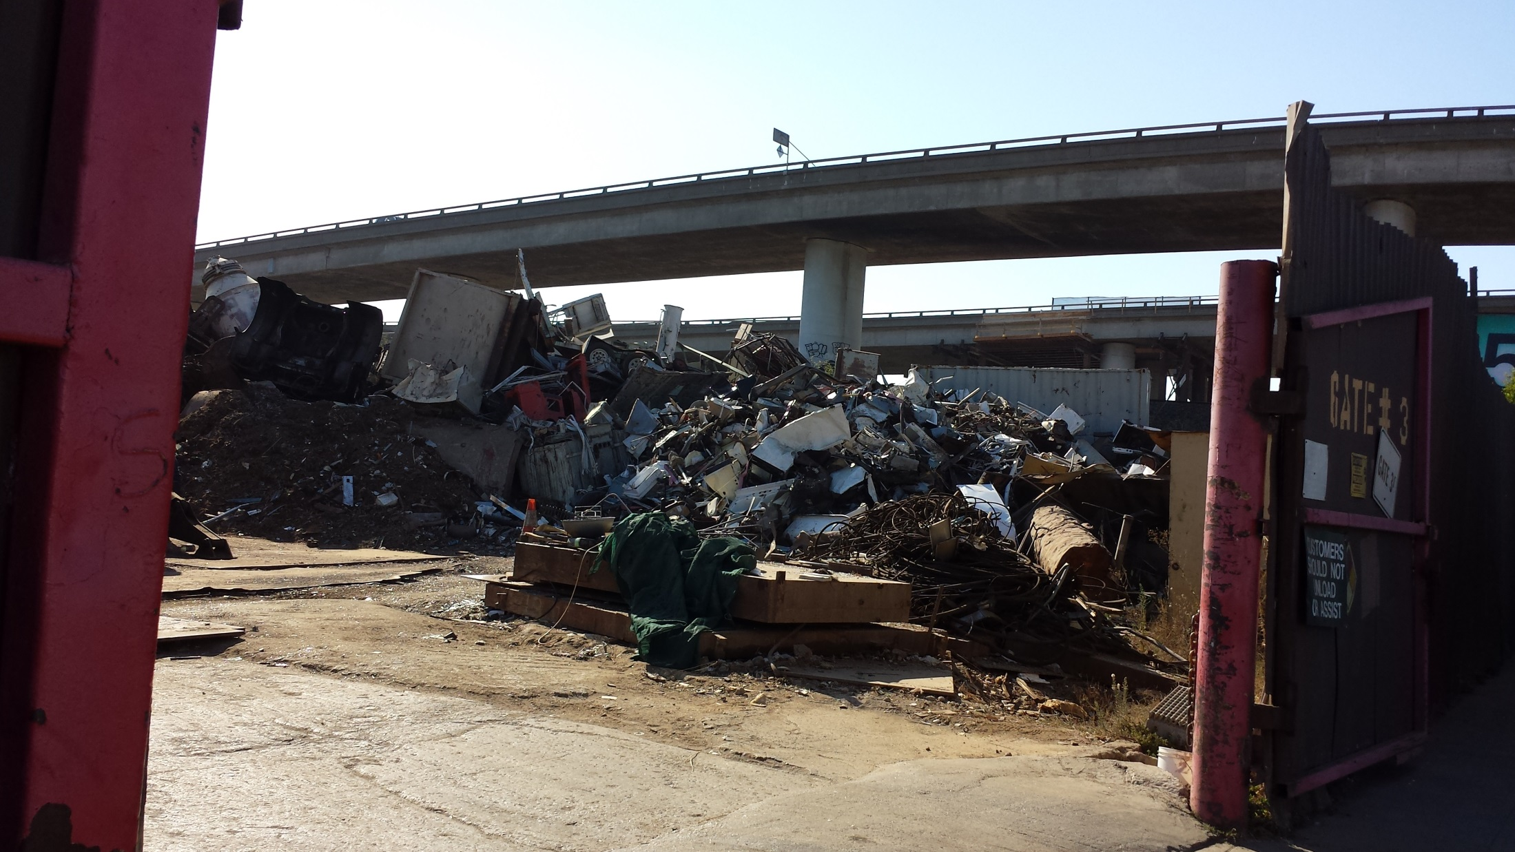
Subtitle
Body text

Slide 4
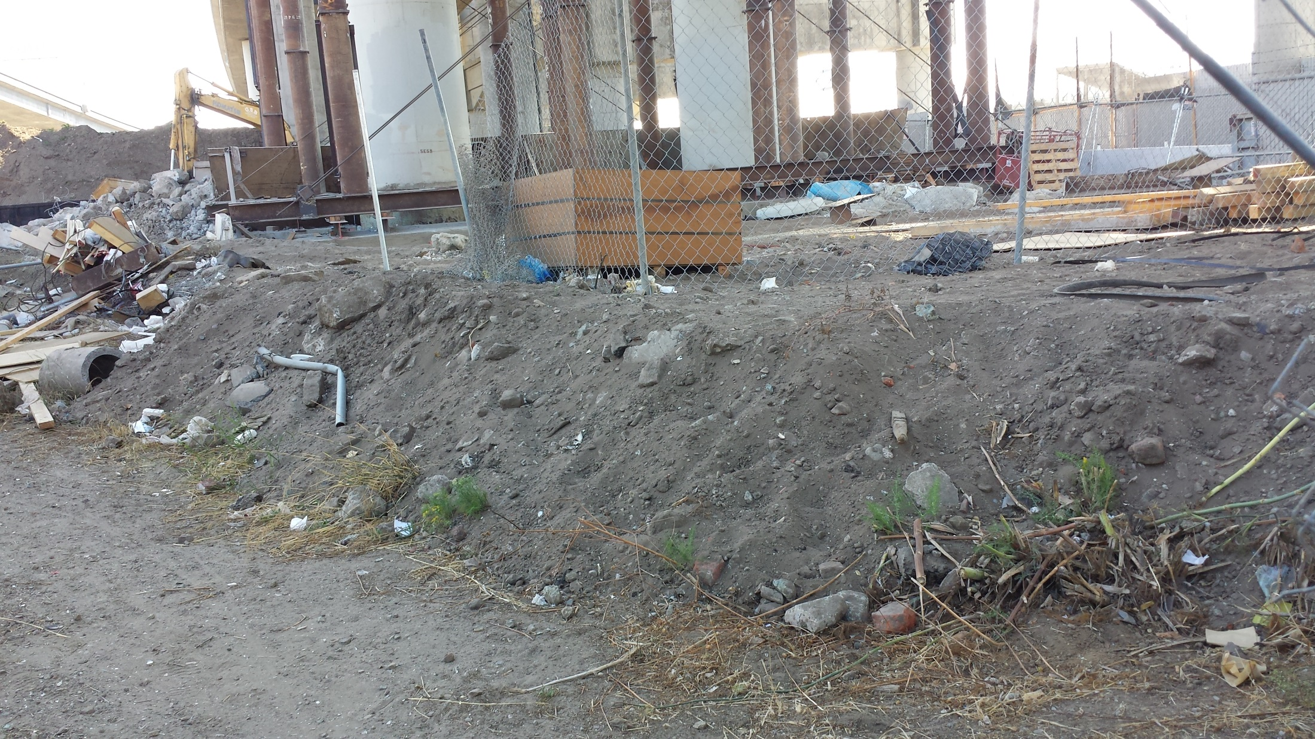

Slide 5
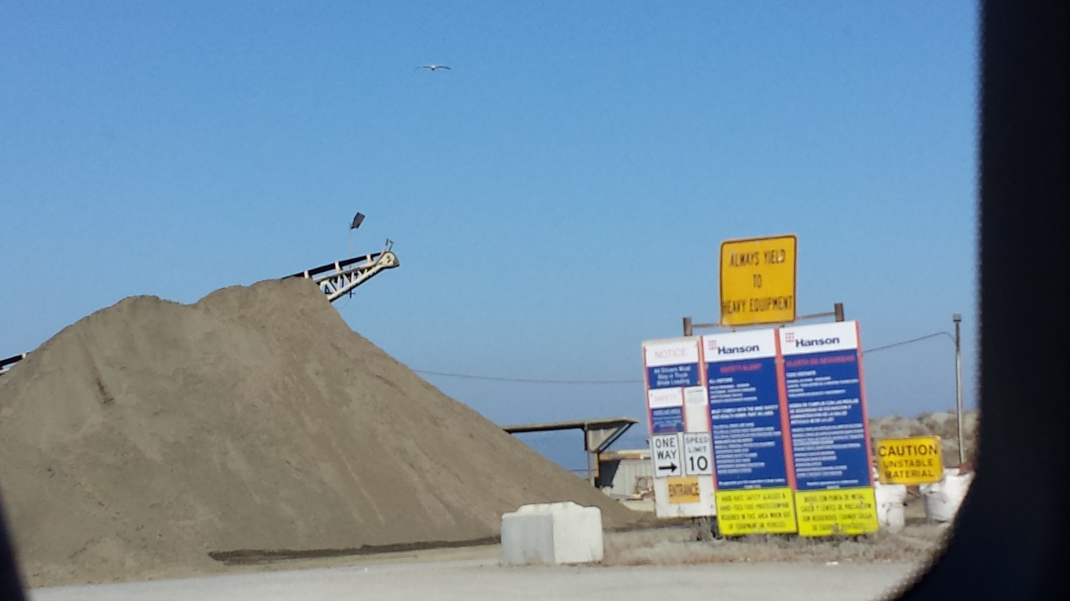

Slide 6
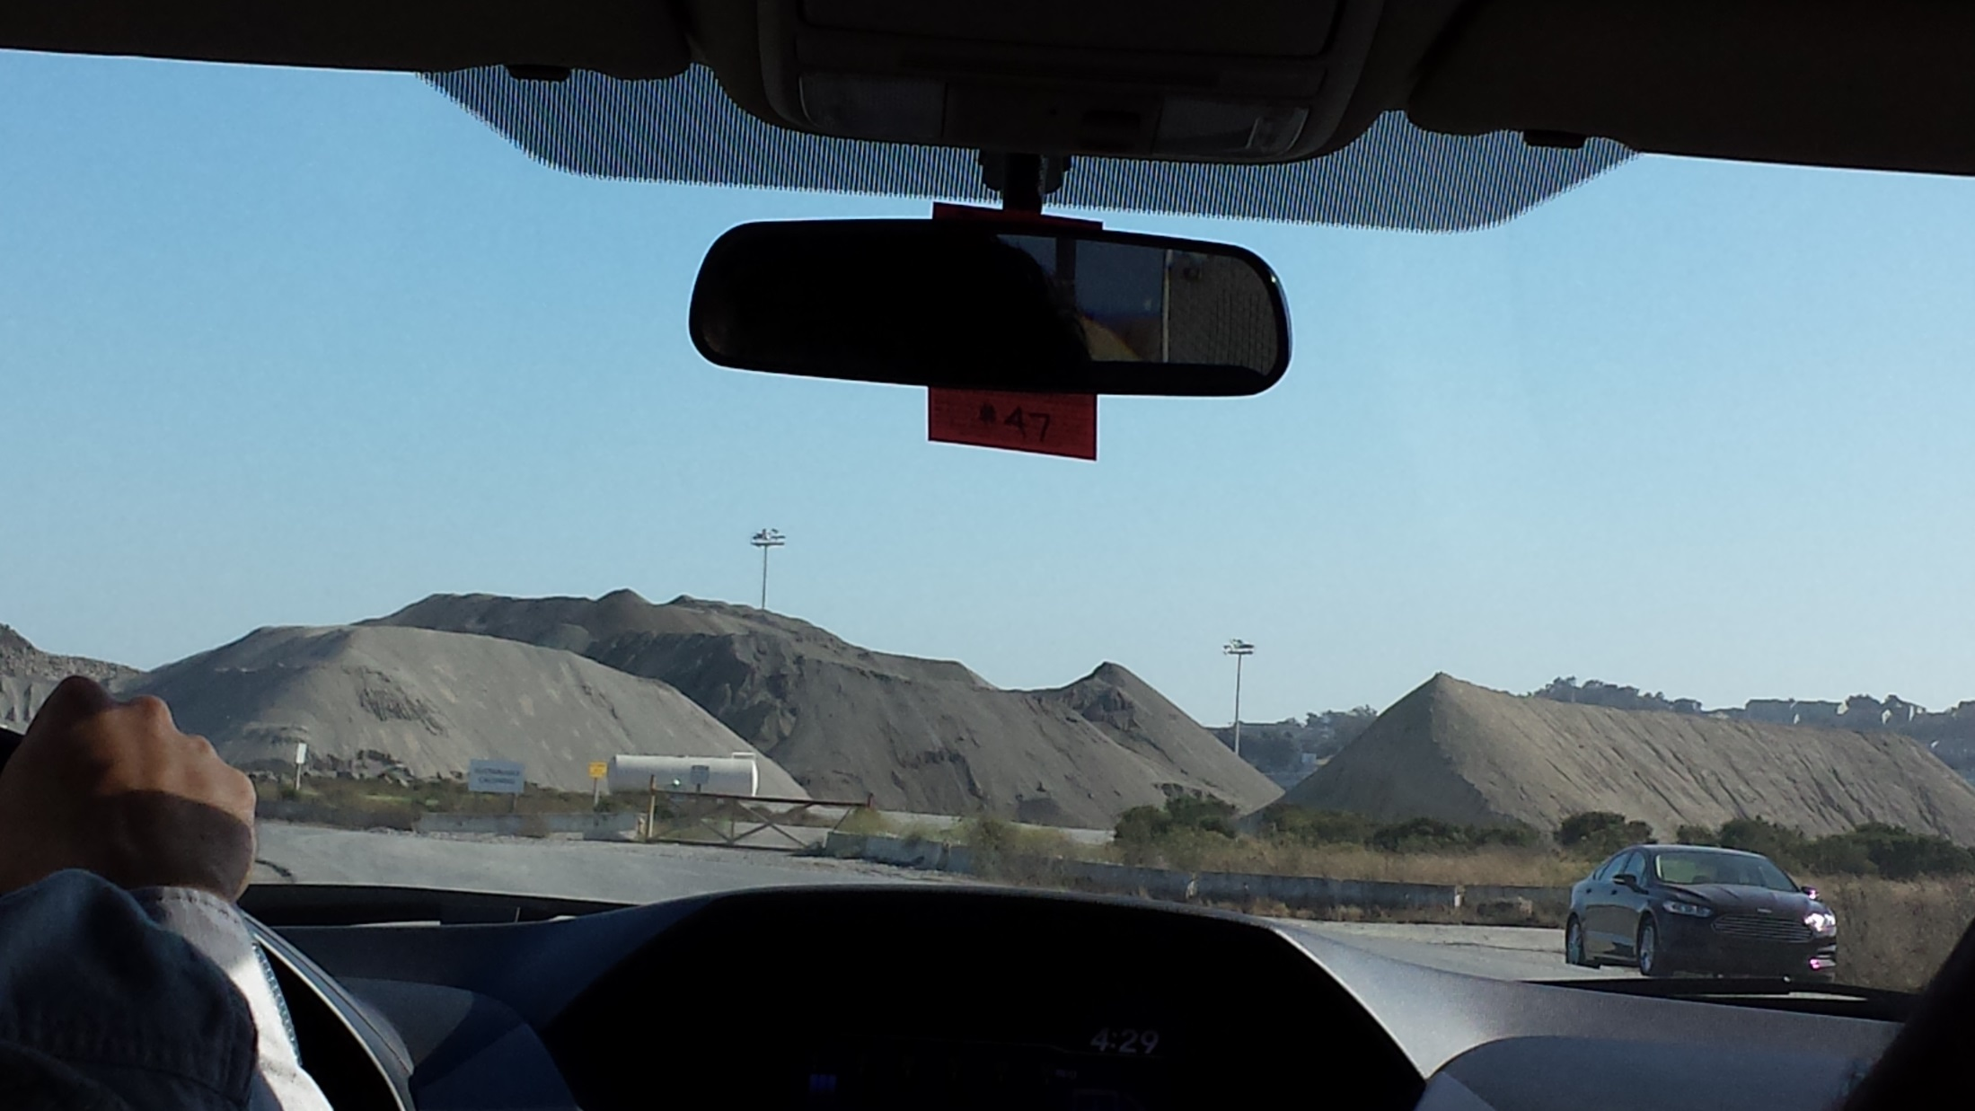

Slide 7
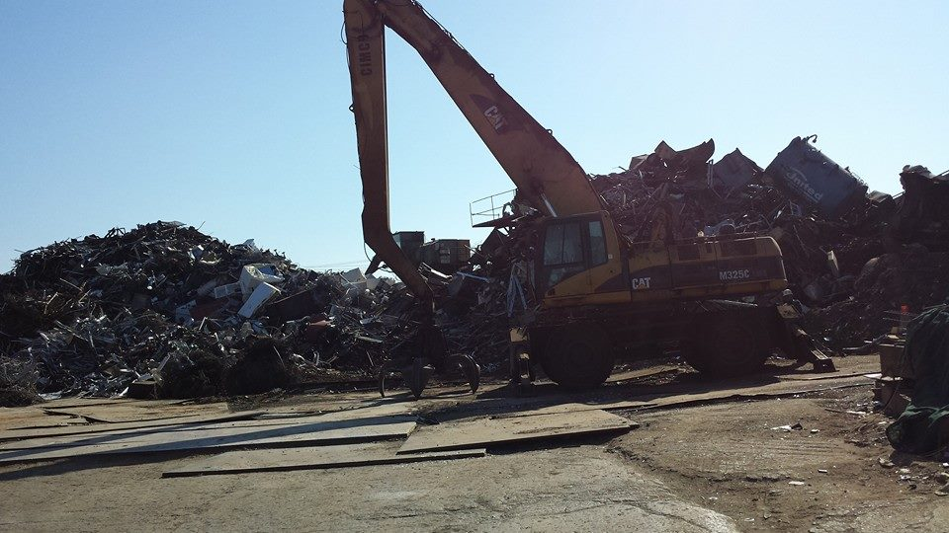

Slide 8
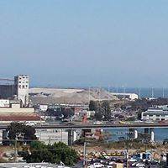

Slide 9
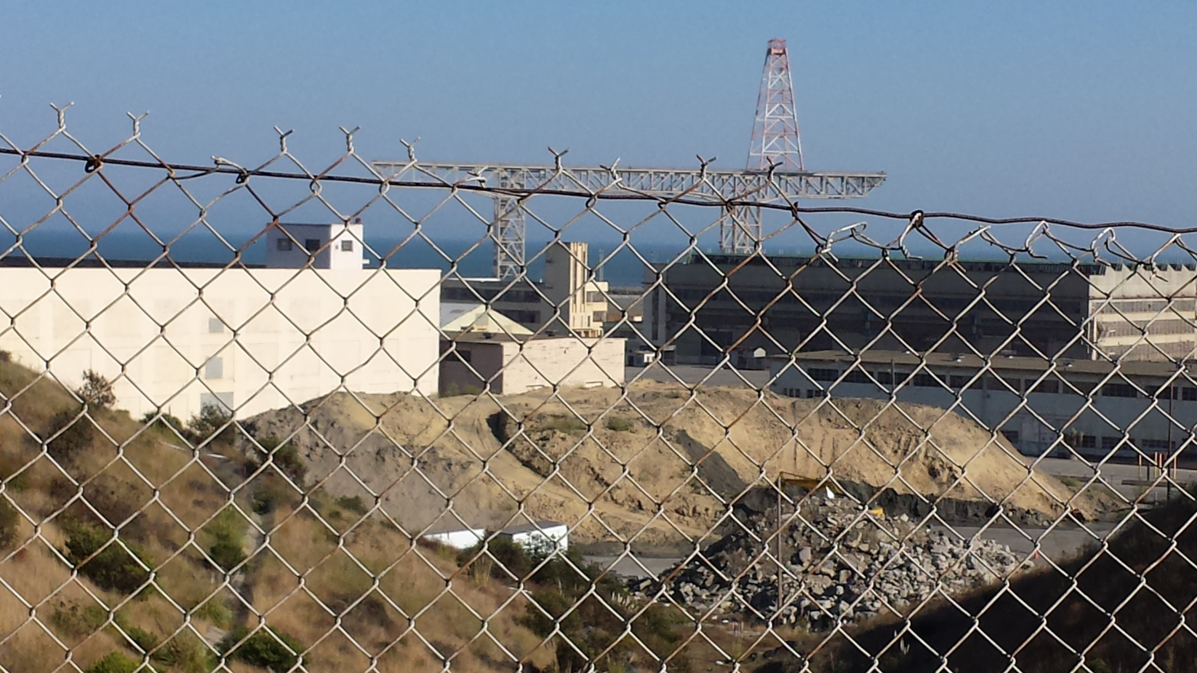

Slide 10
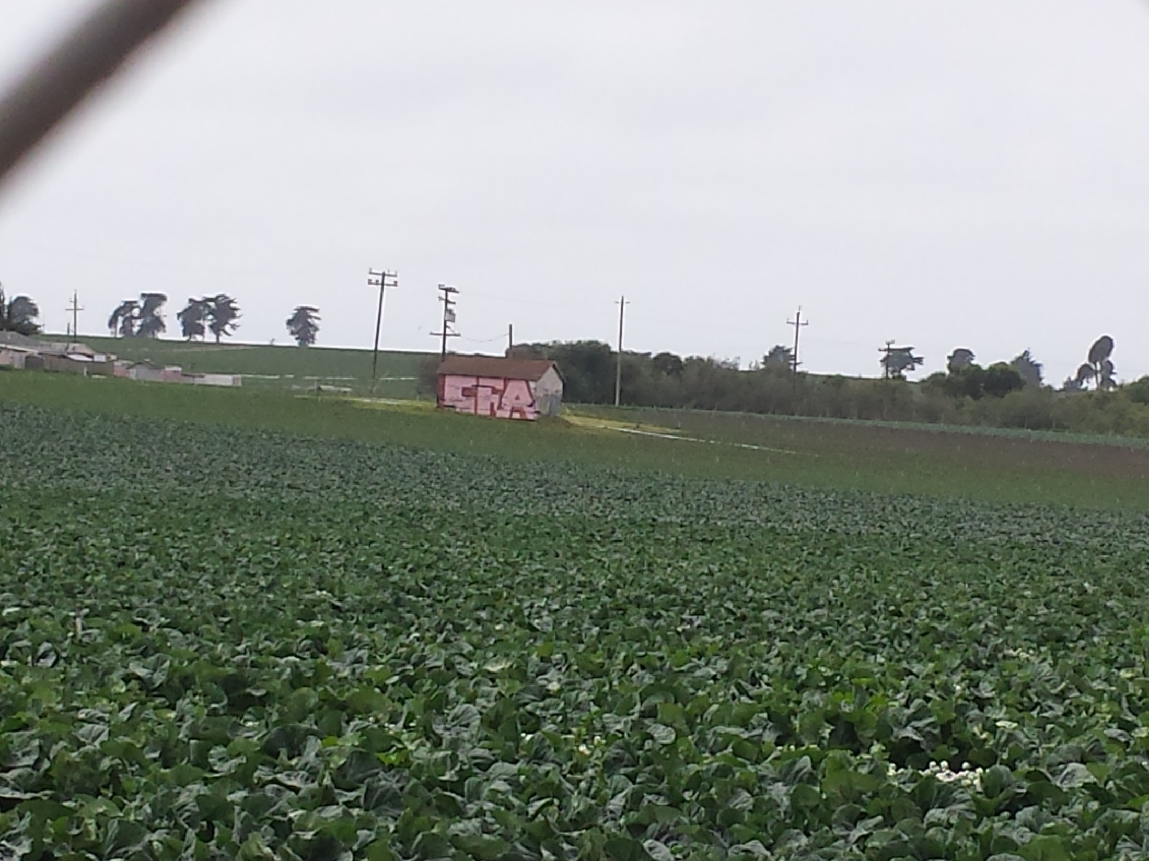
Topic 1 in Blue Font
Subtitle
Body text

Slide 11
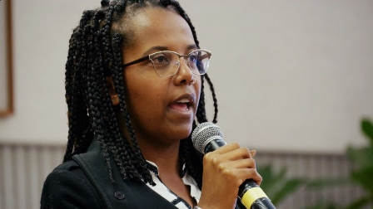

Slide 13
