Slide 1
DE Law School
Dignity Rights and Environmental Justice
April 13, 2018
Solving Environmental Injustices Through Collaborative Partnerships
Marva E. King, PhD

Slide 2
Historical EJ Perspectives Impact EPA
NEJAC guides EPA to Collaborative Problem Solving (CPS)
CPS helps solve Environmental Injustices

Slide 3
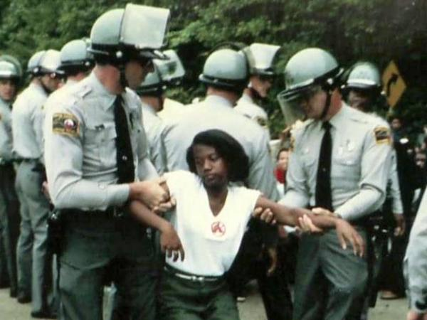
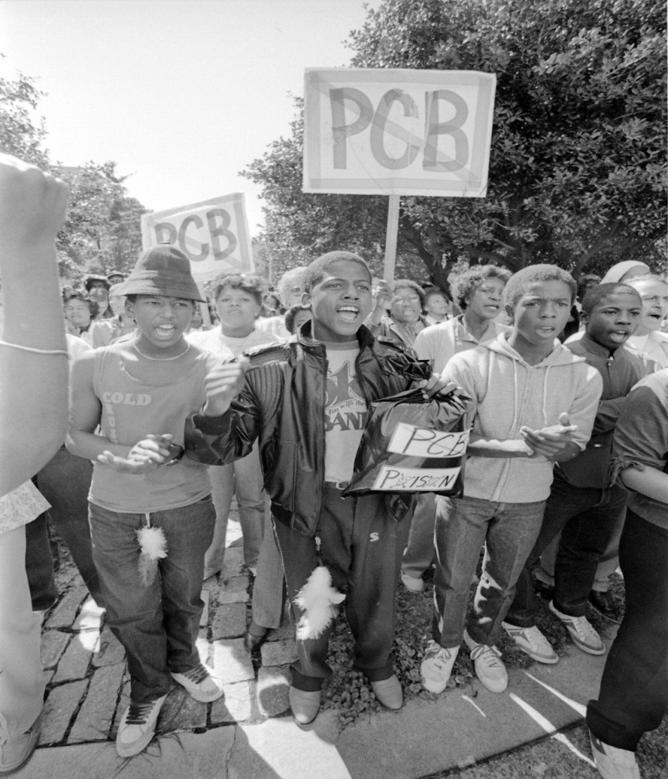
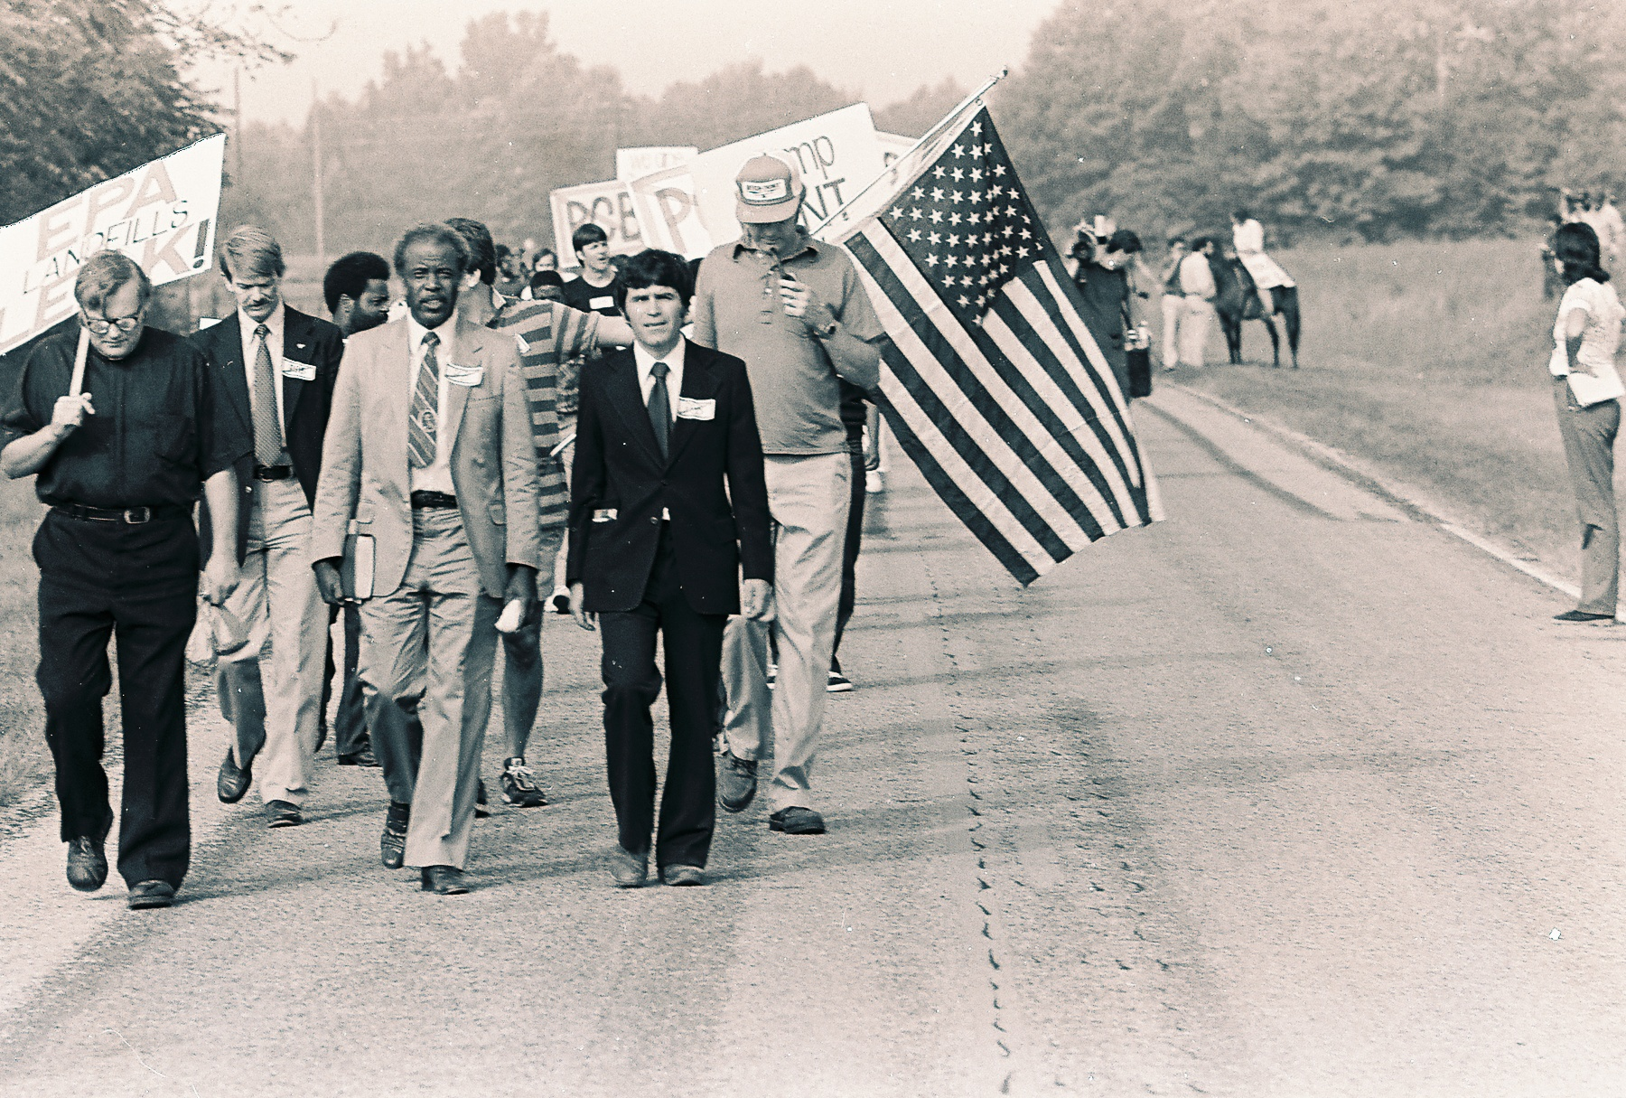
Warren County: The Beginning of a National Movement
1982 -- Warren County, North Carolina
  Protests of construction of hazardous waste landfill near Warrenton, North Carolina
  500 people arrested
Notes:
State planned to bury 400,000 cubic yards polychlorinated biphenyls (PCBs) contaminated soil. Location chosen from 90 sites across state: County was 64 percent black; Unincorporated Shocco Township, site of the landfill, was 75 percent black; County ranked ninety-seventh in per capita income ($6,984) out of North Carolina's one hundred counties

Slide 4
Early Government EJ Actions
EPA establishes the Office of Environmental Equity (later changed to Office of EJ)
EJ Coordinators (Regions/HQTRS)
National Environmental Justice Advisory Council
Clinton 1994 EO Environmental Justice 12898
Federal Actions to Address Environmental Justice in Minority Populations and Low Income Populations
Interagency Working Group on EJ established with EPA as lead
4
Notes:
Low-income populations; Minority populations (i.e., people of color); Native American populations (i.e., indigenous populations and Tribes)
Directed federal agencies to consider environmental justice in their programs and policy decision
Established the Interagency Working Group on Environmental Justice

Slide 5
NEJAC Policy Implementation
Model Plan for Public Participation (1996 and 2000)
National EJ Roundtables (1996-1999)
Environmental Justice, Urban Revitalization, and Brownfields: The Search For Authentic Signs Of Hope (1996)
Fish Consumption and EJ (2002)

Slide 6
NEJAC Policy Implementation
Promote Better Understanding Community Based Participatory Research Methods & Effective Interagency Cooperation
Institute a “bias for action” through utilizing an EJ CPS Model.
Promote paradigm shift to community based approaches
Efficient screening, targeting and prioritization methods/tools to id communities needing immediate intervention

Slide 7
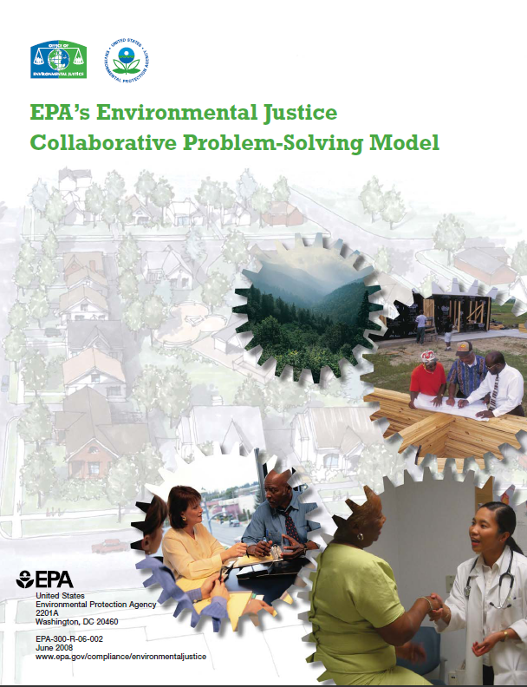
Tool: Collaborative Problem-Solving
1. Issue Identification,
Community Vision
2. Community
Capacity-Building
EJ CPS Model
7. Evaluation,
Lessons Learned
3. Consensus Building
6. Sound Management
4. Multi-Stakeholder
Partnerships
5. Supportive &
Facilitative Role of
Government

Slide 8
Tool: CARE Model

Slide 9
EJ Collaboration Elements
Community Partnership Capacity Building (includes trust building; dignity behavior)
Engaging Business Stakeholders
Utilizing Environmental/Public Health Tools
Onsite Government Technical Advice
Additional Financial Resources/In-kind Services

Slide 10
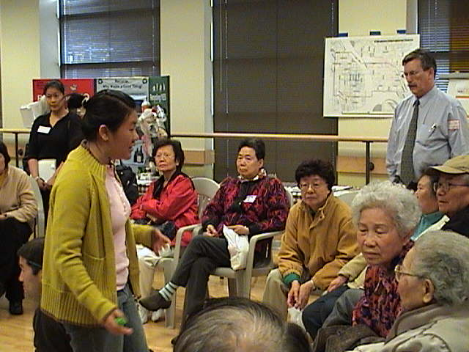
Solutions Achieved From Community Partnerships
Risk reduction - unattainable through national regulations
An improved understanding of risk
Access to technical experts and tools
Collaborative solutions to environmental problems
A proven track record of building partnerships and trust in communities
Increased capacity for environmental stewardship
A network of communities that learn from and share experiences together

