Slide 1
Death and dignity in Haiti: cholera victims' search for justice from the United Nations
IJDH is the US affiliate of Haitian public interest law firm
Bureau des Avocats Internationaux (BAI)

Slide 2
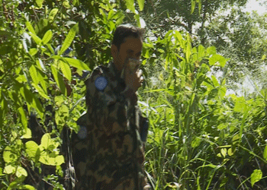
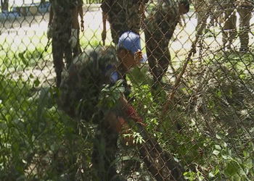
UN’s Introduction of Cholera
© AlJazeera Faultlines
“As we neared, [the Haitians leading us] covered their noses and mouths. The smell was debilitating… A broken PVC pipe…running from near a building of latrines … leaked a foul-smelling black liquid toward the river…”
Jonathan Katz, AP Reporter, The Big Truck That Went By (2013)

Slide 3
Reckless Actions by UN
Troops not tested: Contingents not tested or treated for cholera prior to deployment.
Reckless Waste Disposal: Residents reported nauseating liquid pouring from pipes from the base & journalists documented sewage leaking from pipes and an uncovered disposal pit of fecal matter that periodically overflowed into the tributary running alongside the base.
Systemic Problem: UN audits revealed that problems were part of a systemic sanitation failure across MINUSTAH bases in Haiti. Sanitation problems not corrected until April 2015 (5 years after outbreak)

Slide 4
UN Response
Pan-American Health Organization: “It’s simply rumors … there is no agent, no entity, no person, no structure that is responsible for the introduction of cholera in Haiti…. There is nothing more to say on this and all attempts at stigmatization, pointing fingers, identifying [the source] are erroneous….”
UN Spokesperson: “From our point of view, [the origin] really doesn’t matter.” Dismissed protests as “not genuine,” politically-motivated efforts to disrupt upcoming elections
Head of MINUSTAH: “It’s really unfair to accuse the U.N. for bringing cholera into Haiti.”

Slide 5
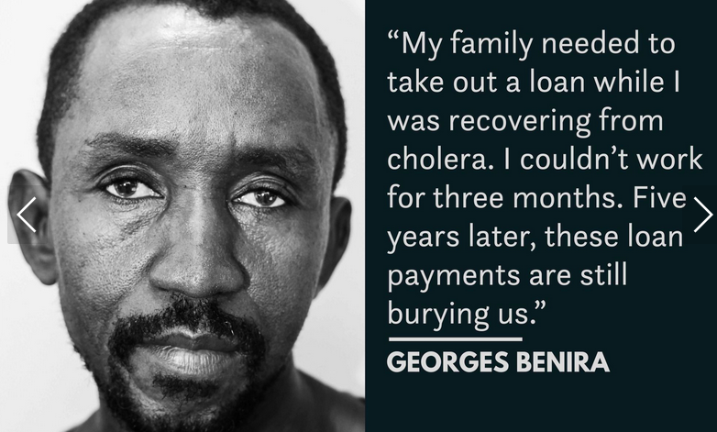
Impact on Victims
Institute for Justice & Democracy in Haiti (www.ijdh.org)

Slide 6
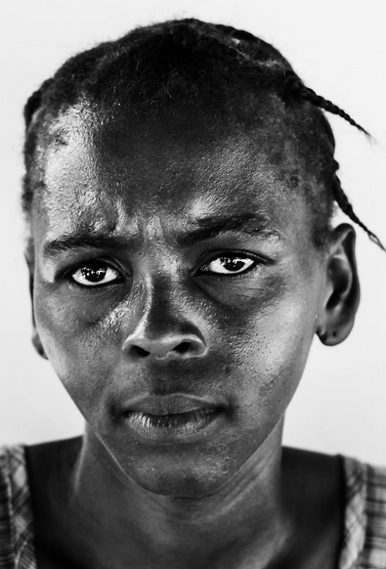
“I am afraid of contracting cholera again. I am afraid for my children.”
_____
RENETTE VIERGELAN
Institute for Justice & Democracy in Haiti (www.ijdh.org)

Slide 7
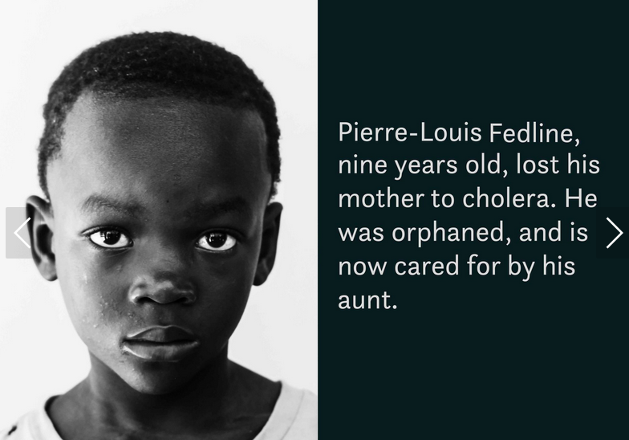
“If the United Nations considered us human beings, there would have been an apology.”
- Community health worker Jean Emmanuel Laros
Institute for Justice & Democracy in Haiti (www.ijdh.org)

Slide 8
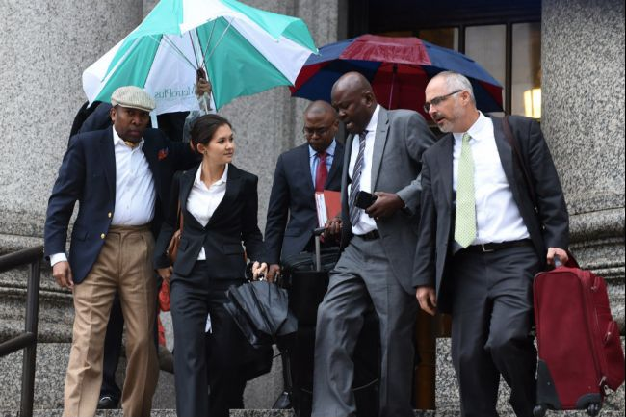
Challenging UN Action through the Courts
Institute for Justice & Democracy in Haiti (www.ijdh.org)

Slide 9
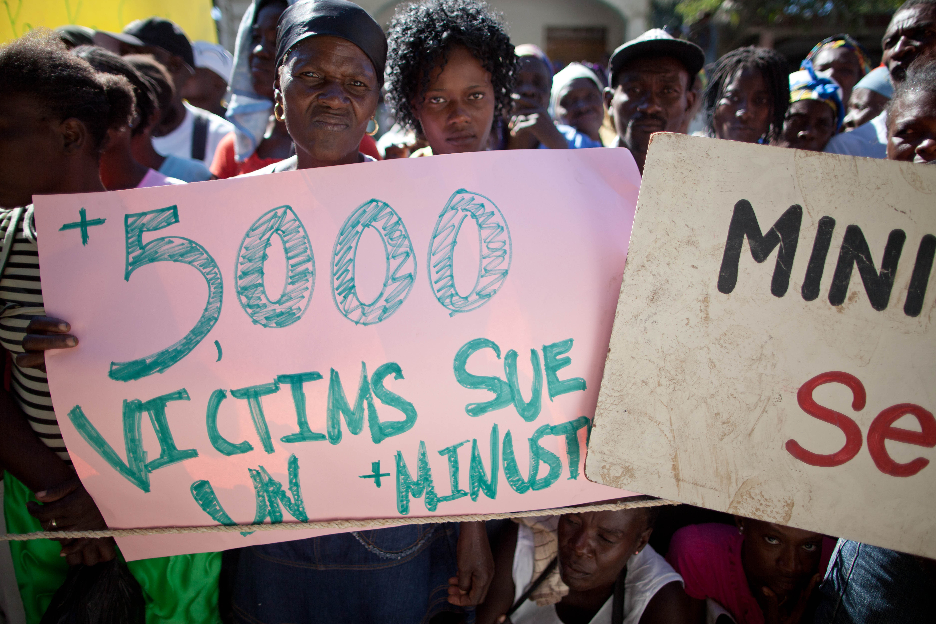
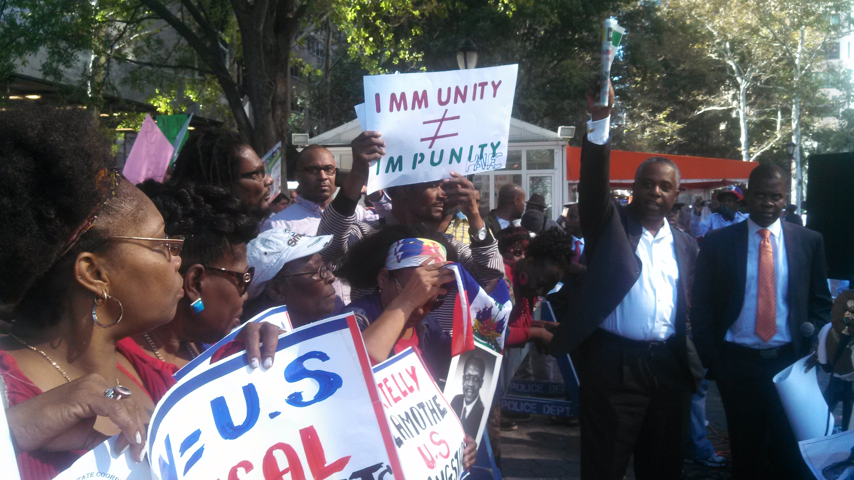
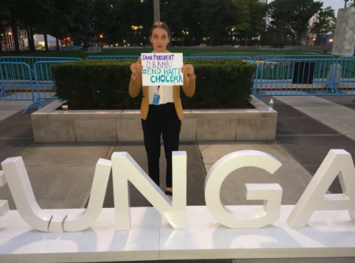
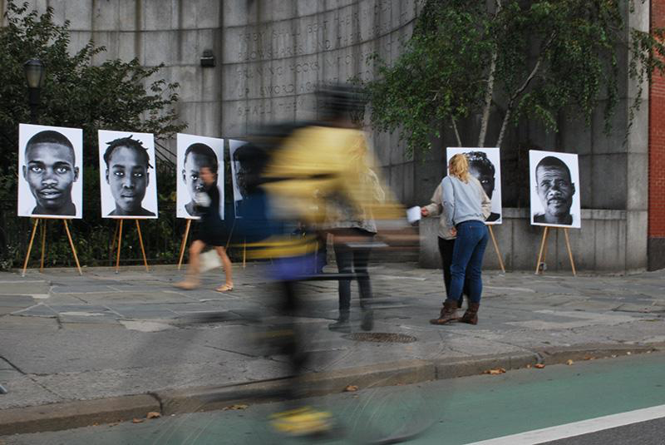
From the Courts to the Streets: Building a Movement for Justice
Institute for Justice & Democracy in Haiti (www.ijdh.org)

Slide 10
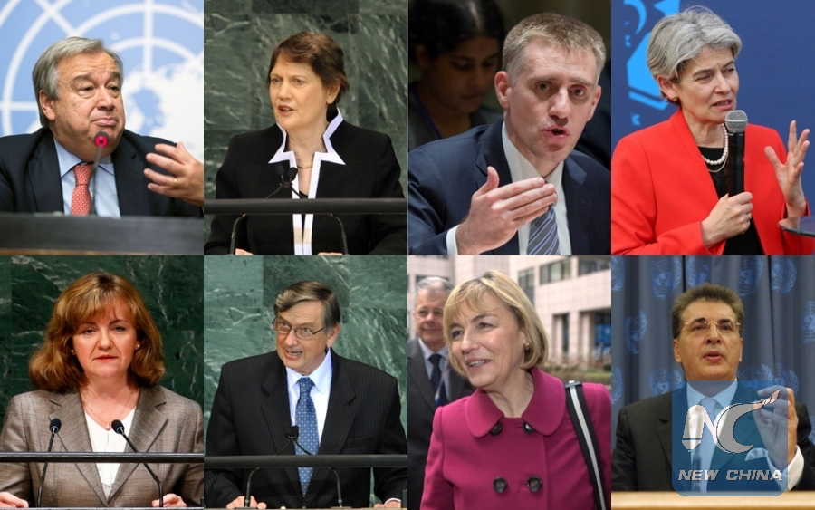
From the Streets to the Halls of Power
Governments
United Nations Human Rights System
“The existing approach is morally unconscionable, legally indefensible, and politically self-defeating. It is also entirely unnecessary.“ – Phillip Alston, UN Special Rapporteur on Extreme Poverty & Human Rights
“I stand by the call that victims of … cholera be provided with compensation.” Navi Pillay, UN High Commissioner for Human Rights
“Each day that passes without an appropriate UN response is a tragedy for the victims, and a stain on the UN’s reputation” – 158 Members of Congress to the State Department
Candidates for Secretary-General
Notes:
What we were up agains

Slide 11
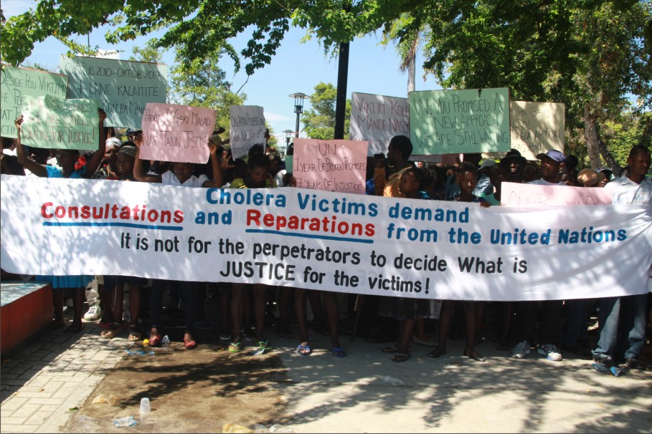
Building Power in Communities

